Slide 1
ArrayLists

Slide 2
Using arrays to store data
Arrays: store multiple values of the same type.
Conveniently refer to items by their index
Need to know the size before declaring them:
int[] numbers = new int[100];
We often need to store an unknown number of values.
Need to either count the values or resize as additional storage space is needed.

Slide 3
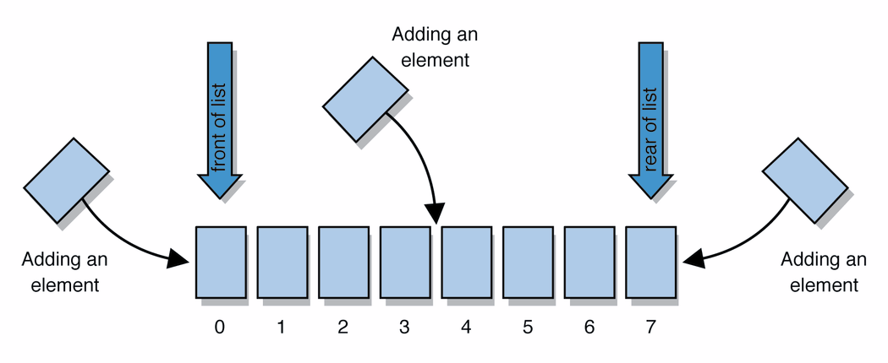
Lists
list: a collection storing an ordered sequence of elements, each accessible by a 0-based index
a list has a size (number of elements that have been added)
elements can be added at any position
Notes:
Let’s take a more abstract view at things

Slide 4
ArrayIntList
Let's consider the methods of a class called ArrayIntList that represents a list using int[]
behavior:
add(value), add(index, value)
get(index), set(index, value)
size()
remove(index)
indexOf(value)
…
The list's size will be the number of elements added to it so far

Slide 5
ArrayIntList
construction
int[] numbers = new int[5];
ArrayIntList list = new ArrayIntList();
storing a given value: retrieving a value
numbers[0] = 42; int val = numbers[0];
list.add(42); int val = list.get(0);
searching for a given value
for (int i = 0; i < numbers.length; i++) {
if (numbers[i] == 27) { ... }
}
if (list.indexOf(27) >= 0) { ... }

Slide 6
Pros/cons of ArrayIntList
pro (benefits)
simple syntax
don't have to keep track of array size and capacity
has powerful methods (indexOf, add, remove, toString)
con (drawbacks)
ArrayIntList only works for ints (arrays can be any type)
Need to learn how to use the class

Slide 7
Java Collections and ArrayLists
Java includes a large set of powerful classes that provide functionality for storing and accessing collections of objects
The most basic, ArrayList, can store any type of Object.
All collections are in the java.util package.
import java.util.ArrayList;

Slide 8
Type Parameters (Generics)
ArrayList<Type> name = new ArrayList<Type>();
When constructing an ArrayList, you can specify the type of elements it will contain between < and >.
We say that the ArrayList class accepts a type parameter, or that it is a generic class.
ArrayList<String> names = new ArrayList<String>();
names.add(”Asa");
names.add(”Nathan");

Slide 9
ArrayList methods
add(value) | appends value at end of list
add(index, value) | inserts given value at given index, shifting subsequent values right
clear() | removes all elements of the list
indexOf(value) | returns first index where given value is found in list (-1 if not found)
get(index) | returns the value at given index
remove(index) | removes/returns value at given index, shifting subsequent values left
set(index, value) | replaces value at given index with given value
size() | returns the number of elements in list
toString() | returns a string representation of the list such as "[3, 42, -7, 15]"

Slide 10
ArrayList methods 2
addAll(list) addAll(index, list) | adds all elements from the given list at the end of this list inserts the list at the given index of this list
contains(value) | returns true if given value is found somewhere in this list
containsAll(list) | returns true if this list contains every element from given list
equals(list) | returns true if given other list contains the same elements
remove(value) | finds and removes the given value from this list
removeAll(list) | removes any elements found in the given list from this list
retainAll(list) | removes any elements not found in given list from this list
subList(from, to) | returns the sub-portion of the list between indexes from (inclusive) and to (exclusive)
toArray() | returns an array of the elements in this list
Notes:
two lists are defined to be equal if they contain the same elements in the same order.

Slide 11
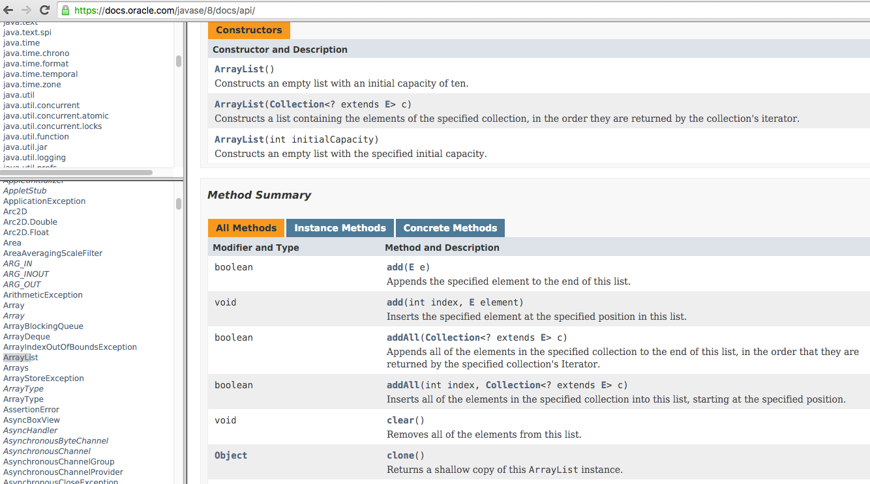
Learning about classes
The Java API specification website contains detailed documentation of every Java class and its methods.
https://docs.oracle.com/javase/8/docs/api/

Slide 12
Iterating through an array list
Suppose we want to look for a value in an ArrayList of Strings.
for (int i = 0; i < list.size(); i++) {
if(value.equals(list.get(i)){
//do something
}
}
Alternative:
for (String s : list) {
if(value.equals(s)){
//do something
}
}

Slide 13
Note on generics in Java 7 and above
In version 7 of Java, rather than doing:
ArrayList<Type> name = new ArrayList<Type>();
You can save a few keystrokes:
ArrayList<Type> name = new ArrayList<>();

Slide 14
Modifying while looping
Consider the following flawed pseudocode for removing elements that end with ‘s’ from a list:
removeEndS(list) {
for (int i = 0; i < list.size(); i++) {
get element i;
if it ends with an 's', remove it.
}
}
What does the algorithm do wrong?
index | 0 | 1 | 2 | 3 | 4 | 5
value | "she" | "sells" | "seashells" | "by" | "the" | "seashore"
size | 6

Slide 15
ArrayList of primitives?
The type you specify when creating an ArrayList must be an object type; it cannot be a primitive type.
The following is illegal:
// illegal -- int cannot be a type parameter
ArrayList<int> list = new ArrayList<int>();
But we can still use ArrayList with primitive types by using special classes called wrapper classes in their place.
ArrayList<Integer> list = new ArrayList<Integer>();

Slide 16
Wrapper classes: Example
Every java primitive has a class dedicated to it.
Example:
int x = 3;
Integer y = new Integer(5);
int z = x + y;
int z = x + y.intValue(); // convert wrapper to primitive
// can also construct an Integer from a string:
y = new Integer(“5”);

Slide 17
ArrayLists of wrapper type objects
A wrapper is an object whose purpose is to hold a primitive value and to provide more functionality.
Once you construct the list, use it with primitives as normal (autoboxing):
ArrayList<Double> grades = new ArrayList<Double>();
grades.add(3.2);
grades.add(2.7);
Primitive Type | Wrapper Type
int | Integer
double | Double
char | Character
boolean | Boolean
float | Float

Slide 18
ArrayLists of wrapper type objects
Autoboxing:
ArrayList<Double> grades = new ArrayList<Double>();
// Autoboxing: create Double from double 3.2
grades.add(3.2);
grades.add(2.7);
double sum = 0.0;
for (int i = 0; i < grades.size(); i++) {
//AutoUNboxing from Double to double
sum += grades.get(i);
}
...

Slide 19
Java Collections
ArrayList belongs to Java’s Collections framework.
Other classes have a very similar interface, so it will be easier to learn how to use those classes once you’ve learned ArrayList

Slide 20
Looking ahead: Interfaces
A Java interface specifies which public methods are available to a user
A class implements an interface if it provides all the methods in the interface
Interfaces allow for common behavior amongst classes. Example: the List interface is implemented by several Collections classes (LinkedList, ArrayList, Vector, Stack)

Slide 21
Linked Lists
public class StrangeObject {
String name;
StrangeObject other;
}

Slide 22
Preliminaries
Arrays are not always the optimal data structure:
An array has fixed size – needs to be copied to expand its capacity
Adding in the middle of an array requires copying all subsequent elements
ArrayLists have the same issues since they use arrays to store their data.

Slide 23
Objects and references
Object variables do not actually store an object; they store the address of an object's location in the computer's memory (references / pointers).
Example:
int [] values = new int[5];
int x = 1;
values
5 | 7 | 10 | 6 | 3
x | 1

Slide 24
Java References
When one reference variable is assigned to another, the object is not copied; both variables refer to the same object.
int[] a1 = {4, 5, 2, 12, 14, 14, 9};
int[] a2 = a1; //refers to same array as a1
a2[0] = 7;
System.out.println(a1[0]); // 7
a1
index | 0 | 1 | 2 | 3 | 4 | 5 | 6
value | 4 | 5 | 2 | 12 | 14 | 14 | 9
index | 0 | 1 | 2 | 3 | 4 | 5 | 6
value | 7 | 5 | 2 | 12 | 14 | 14 | 9
a2

Slide 25
Self references
Consider the following class:
public class StrangeObject {
String name;
StrangeObject other;
}
Will this compile?

Slide 26
Linking self-referential nodes
public class IntegerNode {
int item;
IntegerNode next;
}
Each node object stores:
one piece of integer data
a reference to another node
IntegerNode objects can be "linked" into chains to store a list of values:
item | next
42
item | next
-3
item | next
17
item | next
9 | null

Slide 27
The complete IntegerNode class
public class IntegerNode {
private int item;
private IntegerNode next;
public IntegerNode(int item) {
this.data = item;
this.next = null;
}
public IntegerNode(int item, IntegerNode next) {
this.item = item;
this.next = next;
}
public void setNext(IntegerNode nextNode) {
next = nextNode;
}
public IntegerNode getNext() {
return next;
}
public Object getItem() {
return item;
}
public void setItem(Object item){
this.item = item;
}
}

Slide 28
Exercise
public class IntegerNode {
private int item;
private IntegerNode next;
public IntegerNode(int item) {...}
public IntegerNode(int item, IntegerNode next) {...}
public void setNext(IntegerNode nextNode) {...}
public IntegerNode getNext() {...}
}
Exercise: Write code to produce the following list
item | next
42
item | next
-3
item | next
17
item | next
9 | null

Slide 29
Exercise
What set of statements turns this list:
Into this?
item | next
10
item | next
20
list
item | next
30
item | next
10
item | next
20
list

Slide 30
Exercise
What set of statements turns this list:
Into this?
list = new IntegerNode(30, list);
item | next
10
item | next
20
list
item | next
30
item | next
10
item | next
20
list

Slide 31
Exercise
Let’s write code that creates the following list:
Which is correct?
a)
list = new IntegerNode(10, new IntegerNode(20));
b)
list = new IntegerNode(20, new IntegerNode(10));
c)
Neither will correctly produce that list
item | next
10
item | next
20
list

Slide 32
Exercise
What set of statements turns this list:
Into this?
item | next
10
item | next
20
list
item | next
10
item | next
20
item | next
30
list

Slide 33
Exercise
What set of statements turns this list:
Into this?
list.getNext().setNext(new IntegerNode(30));
item | next
10
item | next
20
list
item | next
10
item | next
20
item | next
30
list

Slide 34
A more flexible version
public class Node {
private Object item;
private Node next;
public Node(Object item) {
this.item = item;
this.next = null;
}
public Node(Object item, Node next) {
this.item = item;
this.next = next;
}
public void setNext(Node nextNode) {
next = nextNode;
}
public Node getNext() {
return next;
}
public Object getItem() {
return item;
}
public void setItem(Object item){
this.item = item;
}
}
}
Node node = new Node (5);
Java will convert 5 to an instance
of class Integer

Slide 35
Printing a linked list
Suppose we have a chain of nodes:
And we want to print all the items.
item | next
10
item | next
20
item | next
990
head
...

Slide 36
Printing a linked list
Start at the head of the list.
While (there are more nodes to print):
Print the current node's item.
Go to the next node.
How do we walk through the nodes of the list?
head = head.getNext(); // is this a good idea?
item | next
10
item | next
20
item | next
990
head
...

Slide 37
Printing a linked list
To not lose the reference to this first node:
Node current = head;
Move along a list by advancing a Node reference:
current = current.getNext();
item | next
10
item | next
20
item | next
990
head
...

Slide 38
Printing a linked list
Code for printing the nodes of a list:
Node head = ...;
Node current = head;
while (current != null){
System.out.println(current.getItem());
current = current.getNext();
}
Similar to array code:
int[] a = ...;
int i = 0;
while (i < a.length) {
System.out.println(a[i]);
i++;
}

Slide 39
Printing a linked list
Same thing with a for loop
Node head = ...;
for (Node current = head; current != null; current = current.getNext()){
System.out.println(current.getItem());
}
the array version
int[] a = ...;
for (int i = 0; i < a.length; i++) {
System.out.println(a[i]);
}

Slide 40
Interim summary – why should I care?
Linked list:
a self referential structure
Advantage over arrays – no bound on capacity – can grow/shrink as needed (a dynamic structure)
Linked lists are the basis for a lot of data structures
stacks, queues, trees
The primary alternative to arrays

Slide 41
The list interface
Method
object get(index) | Returns the element at the given position
index indexOf(object) | Returns the index of the first occurrence of the specified element
add(object) | Appends an element to the list
add(index, object) | inserts given value at given index, shifting subsequent values right
object remove(index) | Removes the element at the specified position (and returns it)
object remove(object) | Removes the element that corresponds to the given object (and returns it)
int size() | returns the size of the list
boolean isEmpty() | indicates if the list is empty
clear() | removes all elements from the list
index is an int, and object is of type Object

Slide 42
The list interface
public interface ListInterface {
public boolean isEmpty();
public int size();
public void add(int index, Object item)
throws ListIndexOutOfBounds;
public void add(Object item);
public void remove(int index)
throws ListIndexOutOfBounds;
public void remove(Object item);
public Object get(int index)
throws ListIndexOutOfBounds;
public void clear();
}

Slide 43
Linked List: constructor
public class LinkedList {
private Node head;
private int size;
public LinkedList() {
head = null;
size = 0;
}
...
}
LinkedList
head =
size = 0
Notes:
Why do we need the size attribute?

Slide 44
Implementing add
How do we add to a linked list at a given index?
item | next
42
item | next
-3
item | next
17
item | next
9 | null

Slide 45
Implementing add
How do we add to a linked list at a given index?
Did we consider all the possible cases?
item | next
42
item | next
-3
item | next
17
item | next
9 | null

Slide 46
The add method
public void add(int index, Object item){
if (index<0 || index>size)
throw new IndexOutOfBoundsException(”out of bounds”);
if (index == 0) {
head = new Node(item, head);
}
else { // find predecessor of node
Node curr = head;
for (int i=0; i<index-1; i++){
curr = curr.getNext();
}
curr.setNext(new Node(item, curr.getNext()));
}
size++;
}

Slide 47
Implementing remove
// Removes value at a given index
public void remove(int index) {
...
}
How do we remove a node?
head =
size = 3
item | next
42
item | next
-3
item | next
17
element 0
element 1
element 2

Slide 48
Removing a node from a list
Before removing element at index 1:
After:
head =
size = 3
item | next
42
item | next
-3
item | next
20
element 0
element 1
element 2
head =
size = 2
item | next
42
item | next
20
element 0
element 1

Slide 49
Removing the first node from a list
Before removing element at index 0:
After:
head =
size = 3
item | next
42
item | next
-3
item | next
20
element 0
element 1
element 2
head =
size = 2
item | next
-3
item | next
20
element 0
element 1

Slide 50
List with a single element
Before: After:
We must change head to null.
Do we need a special case to handle this?
head =
size = 1
data | next
20
head =
size = 0
element 0

Slide 51
The remove method
public void remove(int index) {
if (index<0 || index >= size)
throw new IndexOutOfBoundsException
("List index out of bounds");
if (index == 0) {
// special case: removing first element
head = head.getNext();
} else {
// removing from elsewhere in the list
Node current = head;
for (int i = 0; i < index - 1; i++) {
current = current.getNext();
}
current.setNext(current.getNext().getNext());
}
size--;
}

Slide 52
The clear method
How do you implement a method for removing all the elements from a linked list?

Slide 53
The clear method
public void clear() {
head = null;
}
Where did all the memory go?
Java’s garbage collection mechanism takes care of it!
An object is elligible for garbage collection when it is no longer accessible (cyclical references don’t count!)
In C/C++ the programmer needs to release unused memory explicitly

Slide 54
Linked lists recursively
We would like to print the elements in a linked list recursively.
What would be the signature of the method?
Base case?
Recursive case?

Slide 55
Recursive linked list traversal – which is correct?
a
private void writeList(Node node) {
if (node != null) {
System.out.println(node.getItem());
writeList(node.getNext());
}
}
private void writeList(Node node) {
if (node != null) {
writeList(node.getNext());
System.out.println(node.getItem());
}
}
b

Slide 56
Recursive linked list traversal
private void writeList(Node node) {
//precondition: linked list is referenced by node
//postcondition: list is displayed. list is unchanged
if (node != null) {
// write the first item
System.out.println(node.getItem());
// write the rest of the list
writeList(node.getNext());
}
}

Slide 57
Recursive backward traversal
We have two ways for recursively traversing a string backwards:
Write the last character of the string s
Write string s minus its last character backward
And
Write string s minus its first character backward
Write the first character of string s

Slide 58
Recursive backward traversal
Translated to our problem:
write the last node of the list
write the list minus its last node backward
And
write the list minus its first node backward
write the first node of the list
Which of these strategies is better for linked lists?

Slide 59
Recursive backward traversal
private void writeListBackward (Node node) {
//precondition: linked list is referenced by node
//postcondition: list is displayed. list is unchanged
if (node != null) {
// write the rest of the list
writeListBackward(node.getNext());
// write the first item
System.out.println(node.getItem());
}
}

Slide 60
Recursive add method
public void add(Object item) {
head = addRecursive(head, item);
}
private Node addRecursive(Node node, Object item) {
if (node == null) {
node = new Node(item, node);
}
else {// insert into the rest of the linked list
node.setNext(addRecursive(
node.getNext(), item));
}
return node;
}

Slide 61
Proof of correctness
private Node addRecursive(Node node, Object item) {
if (node == null) {
node = new Node(item, node);
}
else {// insert into the rest of the linked list
node.setNext(addRecursive(
node.getNext(), item));
}
return node;
}
Base case: If we have reached the end of the list, it correctly returns a link to the newly inserted node
Recursive case: Assuming that the recursive call correctly returns a reference to the rest of the list with the element added, then setting that reference results in correctly adding the node.

Slide 62

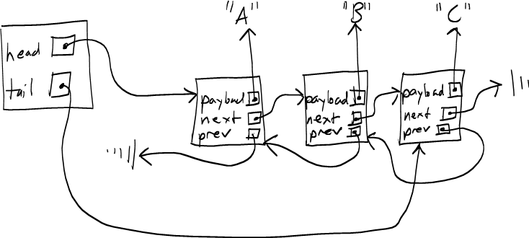
Variations
Circular linked list
Doubly linked list
What are the advantages and disadvantages of a doubly linked list?
image from: http://en.wikipedia.org/wiki/Linked_list

